Slide 1

Operating Systems
Jinghui Zhong （钟竞辉）
Office：B3-515
Email ：jinghuizhong@scut.edu.cn

Slide 2
Session 4
【Objective and Requirement】
Implement a simple command interpreter in Linux. The interpreter should:
1) support both internal and external commands, and internal commands support two (cd, exit, history);
2) able to save 10 historical commands
The following system calls can be used to implement the interpreter:
1) fork() —create a new process;
2) execve() —Load a new program and execute it;
3) wait() —waiting for child process to exist
4) chdir() —change the working direction of a process.
【Environment】
Operating System：Linux;

Slide 3
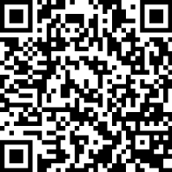
Deadline： 2020/12/28
Submission Link
https://workspace.jianguoyun.com/inbox/collect/39d45c98ccc64e41b53122c490c3837e/submit

